Slide 1



Software Engineering
Non-Functional Requirements (NFRs) by Prof. Mohamad Kassab
Leonidas Kontothanassis kthanasi@bu.edu

Slide 2
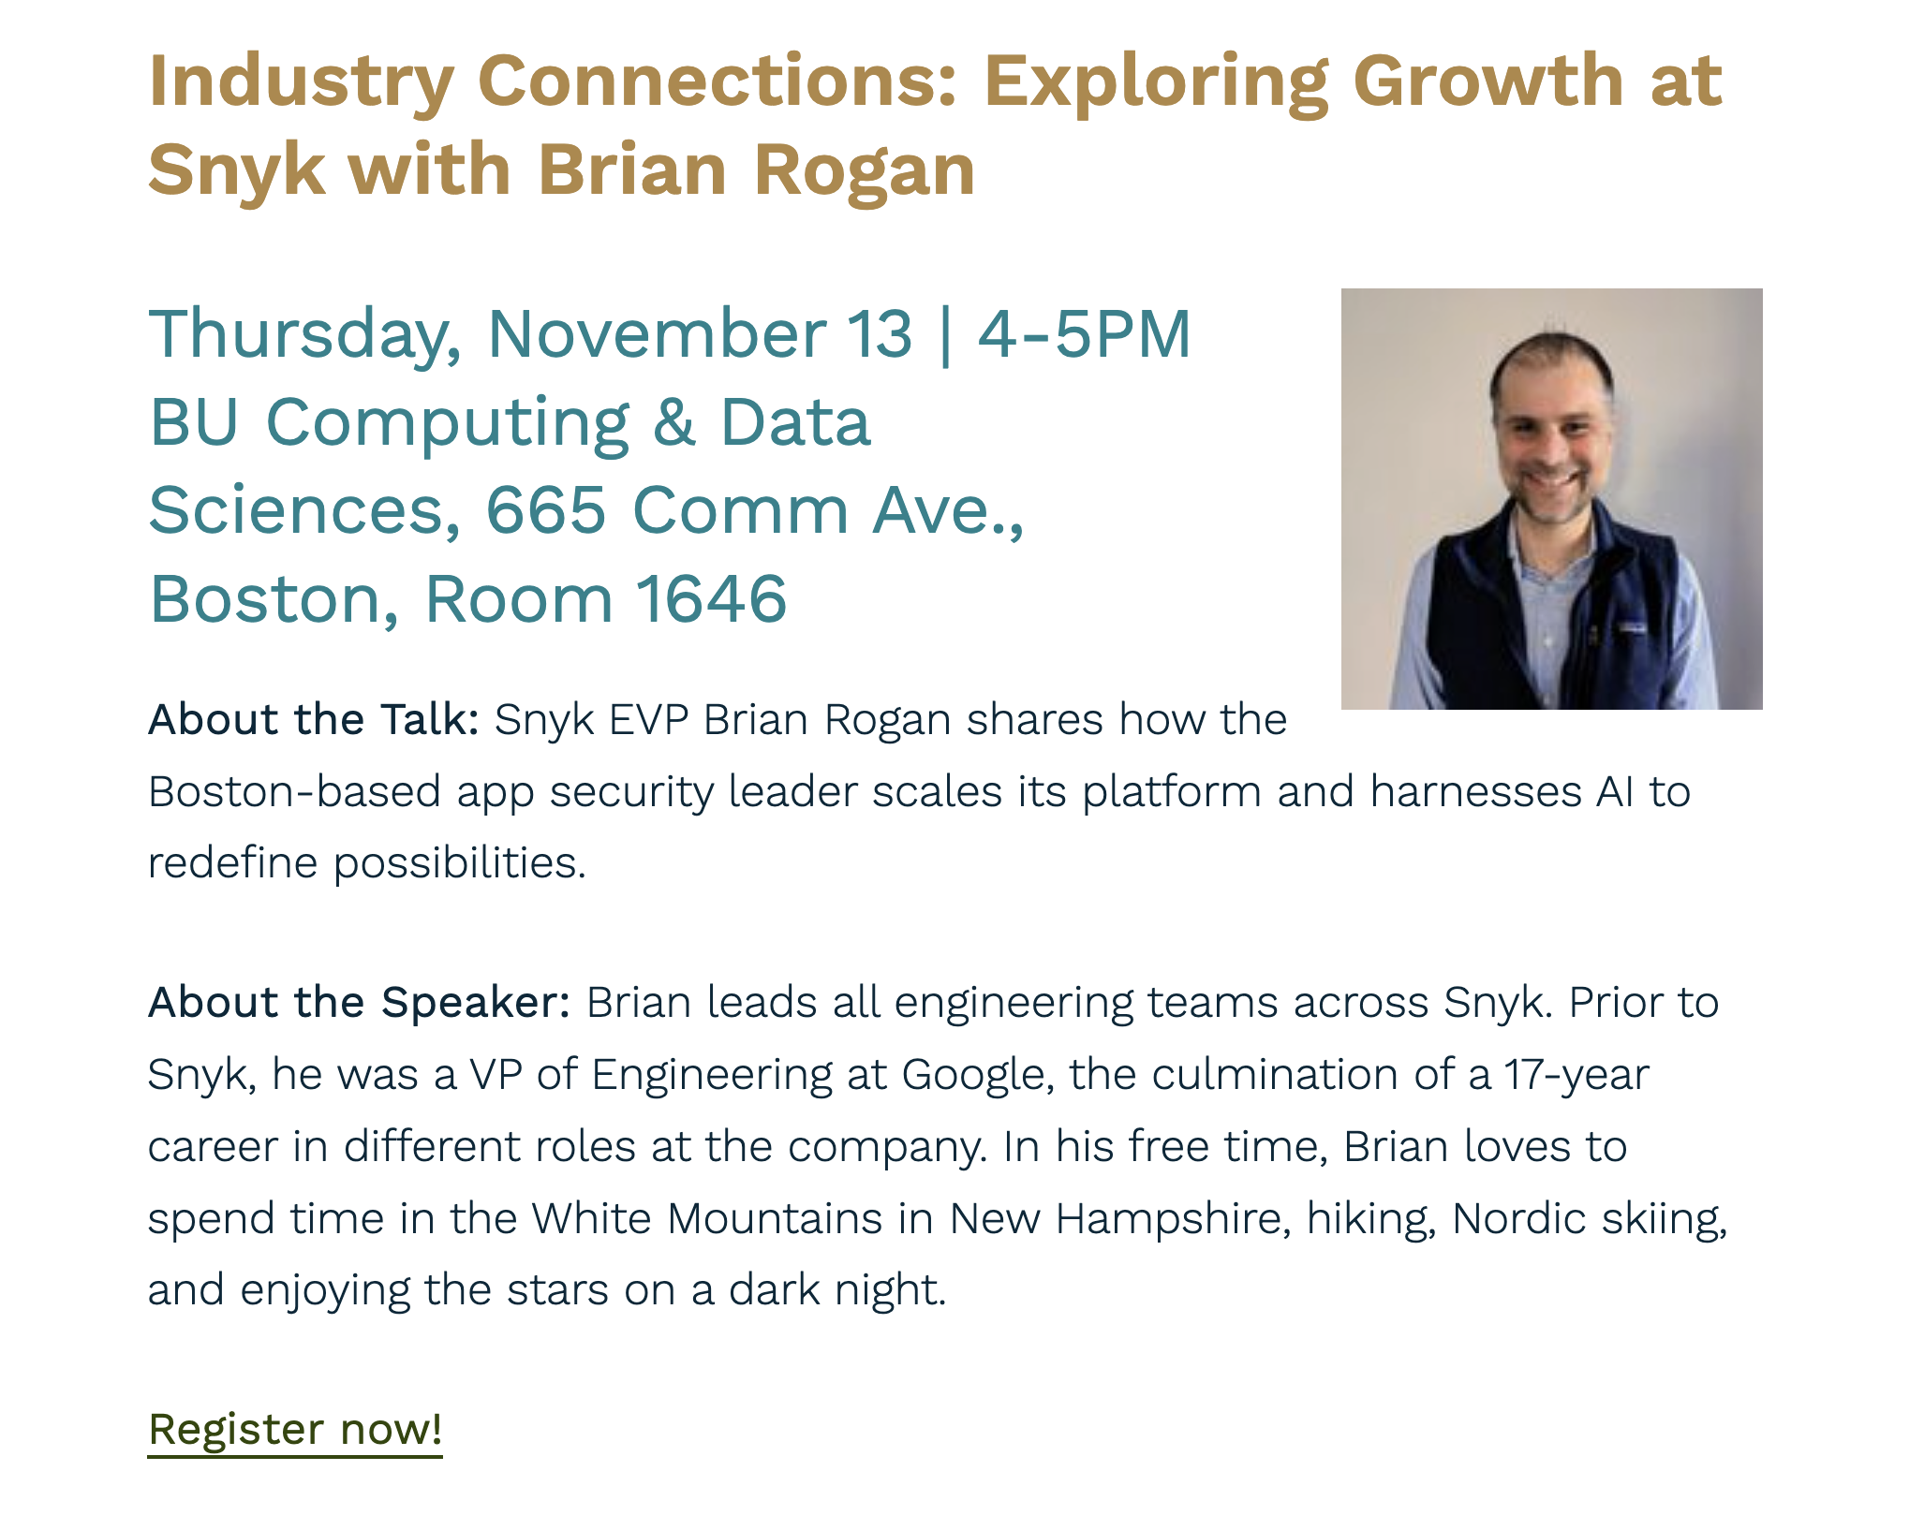

Slide 3

Lesson OUTLINE
What are NFRs?
Different Types of NFRs.
How to Specify Quality Attributes?
Popular Quality Attributes:
Security
Availability
Modifiability
Interoperability
Performance
Testability
Usability

Slide 4

Nonfunctional requirements
Software systems are characterized both by their functional requirements (FRs) (what the system does) and by their nonfunctional requirements (NFRs) (how the system behaves with respect to some observable attributes like reliability, reusability, maintainability, etc.).
In the software marketplace, in which functionally equivalent products compete for the same customer, NFRs become more important.
NFRs receive little attention relative to Functional Requirements.
Notes:
In the software market place, in which functionally equivalent products compete for the same customer, Non Functional Requirements (NFRs) become more important in distinguishing between the competing products.
However, in practice, NFRs receive little attention relative to Functional Requirements (FRs) [WW03]. This is mainly because of the nature of these requirements which poses a challenge when taking the choice of treating them at an early stage of the development process. NFRs are subjective, relative and they tend to become scattered among multiple modules when they are mapped from the n-dimensional requirements domain to the one-dimensional solution space. Furthermore, NFRs can often interact, in the sense that attempts to achieve one NFR can help or hinder the achievement of other NFRs at particular software functionality. Such an interaction creates an extensive network of interdependencies and tradeoffs between NFRs which is not easy to trace or estimate [CNYM00].

Slide 5
What are NFRs?
No consensus in RE community what NFRs really are .
NFRs have been (at best) specified in loose, fuzzy terms that are open to wide negating and interpretations.
The next two slides provide some existing definitions from the literature.

Slide 6
What are NFRs?
There is no such consensus for NFRs:
[BOOK: NON-FUNCTIONAL REQUIREMENTS IN SOFTWARE ENGINEERING]: lists 161 NFRs !!
[IEEE 610.12]: Term is not defined. The standard distinguishes design requirements, implementation requirements, interface requirements, performance requirements, and physical requirements.
[IEEE 29148]: Term is not defined. The standard defines the categories functionality, external interfaces, performance, attributes (portability, security, etc.), and design constraints. Project requirements (such as schedule, cost, or development requirements) are explicitly excluded.
How NFRs are referred to in research articles?
[Anton97]: Describe the nonbehavioral aspects of a system, capturing the properties and constraints under which a system must operate.
[Davis93]: The required overall attributes of the system, including portability, reliability, efficiency, human engineering, testability, understandability, and modifiability.
[Jacobson99]: A requirement that specifies system properties, such as environmental and implementation constraints, performance, platform dependencies, maintainability, extensibility, and reliability. A requirement that specifies physical constraints on a functional requirement.
[Kotonya98]: Requirements which are not specifically concerned with the functionality of a system. They place restrictions on the product being developed and the development process, and they specify external constraints that the product must meet.

Slide 7
What are NFRs?
[Ncube02]: The behavioral properties that the specified functions must have, such as performance, usability.
[Robertson99]: A property, or quality, that the product must have, such as an appearance, or a speed or accuracy property.
[Wiegers03]: A description of a property or characteristic that a software system must exhibit or a constraint that it must respect, other than an observable system behavior.
[Wikipedia_NFR]: Requirements which specify criteria that can be used to judge the operation of a system, rather than specific behaviors.
[Wikipedia_Requirements Analysis]: Requirements which impose constraints on the design or implementation (such as performance requirements, quality standards, or design constraints).
NFRs are also referred to as :
-ilities: understandability, usability, modifiability, inter-operability, reliability, portability, maintainability, scalability, (re-)configurability, customizability, adaptability, variability, volatility, traceability,…
-ities: security, simplicity, clarity, integrity, modularity, ..
-ness: user-friendliness, robustness, responsiveness, completeness, correctness, cohesiveness, …

Slide 8
What are NFRs?
We will move forward with the notion that a Non-Functional Requirement is any requirement that is not explicitly classified as a functional requirement.
Bear in mind that some NFRs (quality attributes) are domain / project specific:
Iowability [Bass12] !
Caring [Kassab17] !
Humanization [Kassab20] !
Each attribute community has developed its own vocabulary.
In software engineering approaches and industrial practices, NFRs are handled separately from FRs of a system at later stages of the development.
But because of this, some software engineering principles such as abstraction,
localization, modularization, uniformity and reusability, can be compromised.

Slide 9
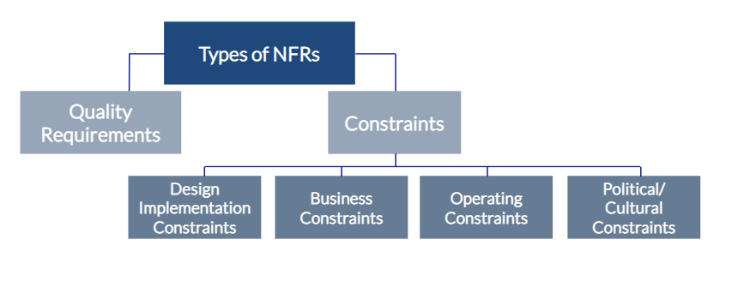
Different Types of NFRs
In the remaining of this lesson, we will focus more on Quality Requirements (Attributes)

Slide 10

How to specify Quality Attributes?
If a functional requirement is "when the user presses the green button the Options dialog appears”:
a performance QA annotation might describe how quickly the dialog will appear;
an availability QA annotation might describe how often this function will fail, and how quickly it will be repaired;
a usability QA annotation might describe how easy it is to learn this function.

Slide 11
How to specify Quality Attributes?
There are three problems with previous discussions of quality attributes:
The definitions provided for an attribute are not testable. It is meaningless to say that a system will be “modifiable”.
Endless time is wasted on arguing over which quality a concern belongs to (see next slide). Is a system failure due to a denial of service attack an aspect of availability, performance, security, or usability?
Each attribute community has developed its own vocabulary. (Remember Iowability quality !)

Slide 12
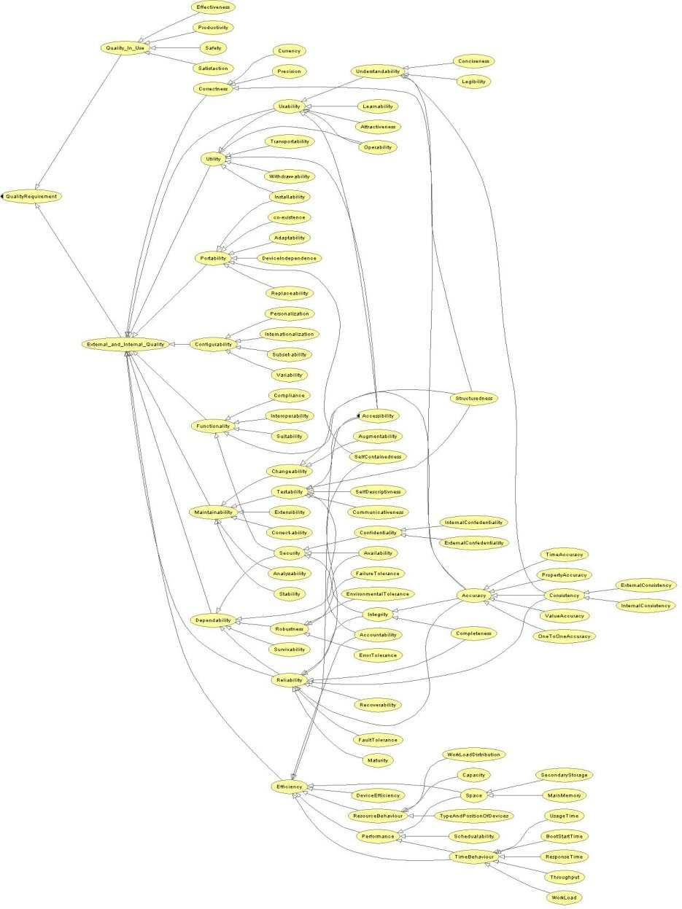
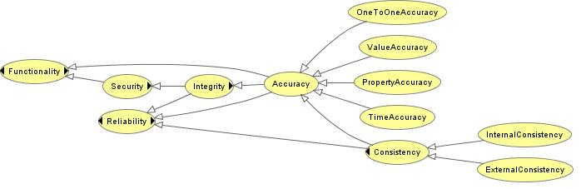
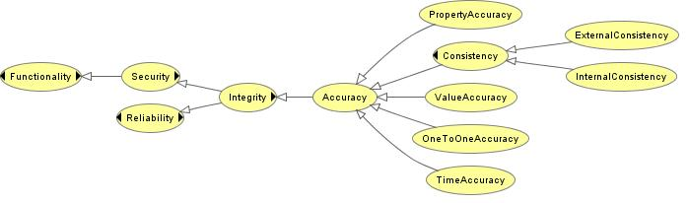
Quality Requirement Taxonomy – 2009 (My Proposal)
Asserted Model for Accuracy quality
Inferred Model for Accuracy quality
Notes:
1- Quality is the totality of characteristics of an entity that bear on its ability to satisfy stated and implied needs [ISO912601].
2- discuss the ISO 9126 and its criticism.
Some qualities are left out and not included in the ISO 9126 (e.g. correctness, interoperability, testability).
3- We built quality taxonomy out of many inputted approaches starting from the ISO 9126-1 (see section 4.7) to define the root nodes for the quality taxonomy (External Quality, Internal Quality and Quality in Use). Figure 4-8 shows the graphical representation of the quality taxonomy.
4- We lists 87 quality requirements, we list their parent qualities according to the defining refernce.

Slide 13

How to specify Quality Attributes?
A solution to these problems is to use “quality attribute scenarios” as a means of characterizing quality attributes.

Slide 14
Specifying Quality Attribute Scenario Requirements
Source of stimulus. This is some entity (a human, a computer system, or any other actuator) that generated the stimulus.
Stimulus. The stimulus is a condition that requires a response when it arrives at a system.
Environment. The stimulus occurs under certain conditions. The system may be in an overload condition or in normal operation, or some other relevant state. For many systems, “normal” operation can refer to one of a number of modes.
Artifact. Some artifact is stimulated. This may be a collection of systems, the whole system, or some piece or pieces of it.
Response. The response is the activity undertaken as the result of the arrival of the stimulus.
Response measure. When the response occurs, it should be measurable in some fashion so that the requirement can be tested.

Slide 15
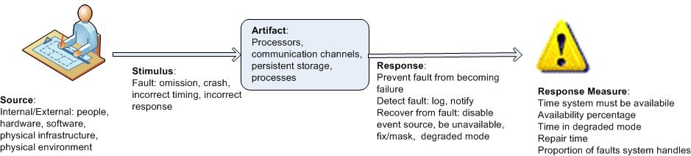
Specifying Quality Attribute Scenario Requirements
Example general scenario for availability:

Slide 16
Specifying Quality Attribute Scenario Requirements
It is not sufficient to state that “The system must be highly available”. Can you tell how??
Instead, a quality scenario shall specify the availability more concretely; for example:
The heartbeat monitor determines that the server is nonresponsive during normal operations. The system informs the operator and continues to operate with no downtime.
Can you determine the 6 elements in the above scenario (stimulus, stimulus source, response, response measure, environment, artifact)?
Notes:
Element Description In this scenario
Stimulus Source The entity that generates the stimulus or detects the problem. Heartbeat monitor (it’s the component detecting the failure)
Stimulus The event or condition that requires a system response. Server becomes nonresponsive (failure detected)
Environment The operating condition when the event occurs. During normal operation
Artifact The part of the system that is affected or reacts. The overall system / server cluster
Response The system’s reaction or behavior after the stimulus. System informs the operator and continues to operate (fails over or uses redundancy)
Response Measure The quantitative or qualitative criteria to judge the response’s success. No downtime (i.e., continuous operation maintained)

Slide 17

Popular Quality Attributes

Slide 18

Security

Slide 19
Security … What is it?
What do we mean when we say security?
In your experience what does this mean?

Slide 20
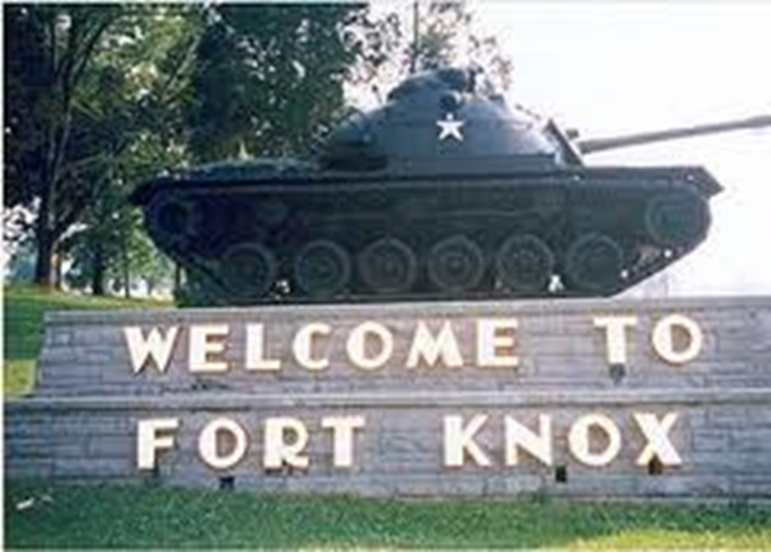
Let’s Look at some Examples

Slide 21
Fort Knox
Fort Knox is a US Army post in Kentucky
In addition to housing various US Army functions it is also the home to a gold bullion depository
5000+ tons of gold housed there

Slide 22
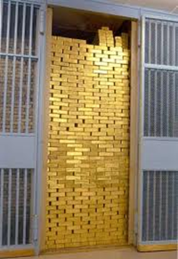
Security
What is the business asset that needs protection in this case?
What does protect mean here?

Slide 23

What About the CIA?
The Central Intelligence Agency (CIA) is a US civilian intelligence organization
Primary purpose is to collect information about foreign governments, corporations, and individuals
It uses this information to influence public policymakers
It does at times engage in tactical operations as well

Slide 24

Security
What is the business asset that needs protection?
What does protect mean in this case?

Slide 25
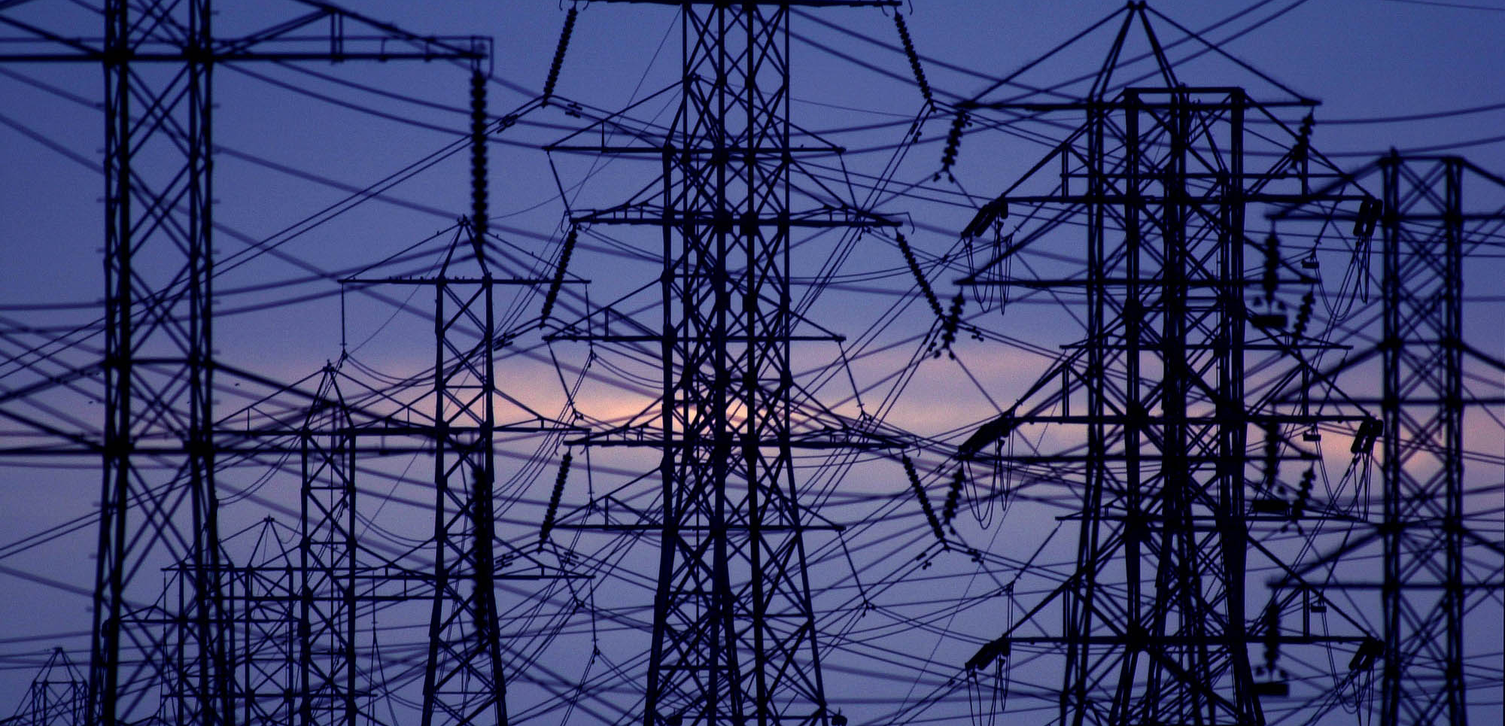
Power Distribution
What would security mean if you have a system that manages the power grid?

Slide 26
In the News
Target’s systems are comprised 2013
40 million credit cards exposed
Niemen Marcus: credit card information for 350,000 customers exposed
And many more
Home Depot
JP Morgan Chase
Jimmy Johns
…
US Public Utilities: Homeland Security confirmed the control systems for several public securities were hacked in 2014

Slide 27

More Detail on Target’s System Breach
Target’s systems were compromised by a stolen password
An HVAC company had access to their networks in order to monitor the systems
This company was actually a Pittsburgh company …
The perpetrators were then able to legitimately gain access to the systems
They installed malware on the Point of Sale (POS) systems
The malware was able to steal 40 million credit cards in 2 ½ weeks

Slide 28
Understanding the Need
We need to understand the business asset that requires protection
We then want to ensure the system protects that business asset
We do this by imagining the ways in which the business asset is at risk
We then articulate the desired response to that risk

Slide 29
Business Context
The business needs differs from one context to another
Organizations have assets they need to protect
They need to protect these assets for different reasons
Business continuity
Liability reasons
Regulation
Protection of IP
…

Slide 30

What is Security?
Based on this discussion, how do you define security?
Security is a measure of the system’s ability to protect data and information from unauthorized access while still providing access to people and systems that are authorized.
An action taken against a computer system with the intention of doing harm is called an attack and can take a number of forms.
It may be an unauthorized attempt to access data or services or to modify data, or it may be intended to deny services to legitimate users.

Slide 31
Security – A Set of Concerns
The related concerns are typically classified as “security” concerns
In software these concerns are typically other quality attributes that are related to security, in particular:
Confidentiality
Data integrity
Non repudiation
Availability

Slide 32
Confidentiality as a part of security
The property that reflects the extent to which:
Data and services are only available to those that are authorized to access them
Is this a concern for a Museum? How about a Financial Institution?

Slide 33
Integrity as a part of security
This property can also refer to data or services
It reflects the extent to which data or services can be delivered as intended
e.g., hopefully the grade that we have recorded for you in this course is correct …

Slide 34
Non Repudiation as a part of security
Nonrepudiation is refers to the ability to guarantee that the sender can not later repudiate or deny having sent the message
It can also refer to the guarantee that the recipient cannot later deny having received the message
When might this be important?

Slide 35
Availability as a part of security
This is the property that reflects the extent to which the system will be available for legitimate use
A denial of service attack is meant to disrupt the availability of a system
We will discuss Availability with more details in few slides.

Slide 36
How to specify security in terms of Quality Scenarios
People often have trouble articulating the security concern
In this area it’s common to articulate the solution
e.g., “System must support login”
This makes it difficult to evaluate the security of the system
Rather than the support for the required mechanism

Slide 37
Security General Scenario
Portion of Scenario | Possible Values
Source | Human or another system which may have been previously identified (either correctly or incorrectly) or may be currently unknown. A human attacker may be from outside the organization or from inside the organization.
Stimulus | Unauthorized attempt is made to display data, change or delete data, access system services, change the system’s behavior, or reduce availability.
Artifact | System services; data within the system; a component or resources of the system; data produced or consumed by the system
Environment | The system is either online or offline, connected to or disconnected from a network, behind a firewall or open to a network, fully operational, partially operational, or not operational
Response | Transactions are carried out in a fashion such that data or services are protected from unauthorized access; data or services are not being manipulated without authorization; parties to a transaction are identified with assurance; the parties to the transaction cannot repudiate their involvements; the data, resources, and system services will be available for legitimate use. The system tracks activities within it by recording access or modification, recording attempts to access data, resources or services, notifying appropriate entities (people or systems) when an apparent attack is occurring.
Response Measure | One or more of the following how much of a system is compromised when a particular component or data value is compromised, how much time passed before an attack was detected, how many attacks were resisted, how long does it take to recover from a successful attack, how much data is vulnerable to a particular attack

Slide 38

Sample Concrete Security Scenario
A disgruntled employee from a remote location attempts to modify the pay rate table during normal operations. The system maintains an audit trail and the correct data is restored within a day.

Slide 39
Security and SSL
The golden standard for encrypting public communications. Must provide
Integrity: Make sure no-one can tamper with message
Easy: Checksum or other signature embedded in the content before encryption. CRC32 quite common
Encryption/Confidentiality: Hide the content of messages
Authentication/Non-repudiation: ensure the participants are who they say they are
def crc32_bitwise(data: bytes) -> int: poly = 0xEDB88320 crc = 0xFFFFFFFF for b in data: crc ^= b for _ in range(8): crc = (crc >> 1) ^ poly if (crc & 1) else (crc >> 1) return (~crc) & 0xFFFFFFFF
Error Type | Detection
1-bit error | Always detected
2-bit error | Always detected
Odd number errors | Always detected
Burst errors ≤ 32 bits | Always detected
Burst errors > 32 bits | Detected with probability 99.99999998 %

Slide 40
Security and SSL
Encryption/Confidentiality: Hide the content of messages. Use AES
Input:
Plaintext block P[4x4] // 16 bytes = 128 bits
Cipher key K[4xNk] // 4x4 (AES-128), 4x6 (AES-192), 4x8 (AES-256)
Output:
Ciphertext block C[4x4]
Procedure AES_Encrypt(P, K):
// 1. Initialize state
state = P
// 2. Initial AddRoundKey
state = state XOR CipherKey
// 4. Perform Nr-1 rounds
for round = 1 to Nr-1:
state = SubBytes(state)
state = ShiftRows(state)
state = MixColumns(state)
state = state XOR CipherKey
// 5. Final round (no MixColumns)
state = SubBytes(state)
state = ShiftRows(state)
state = state XOR CipherKey
// 6. Output ciphertext
return state

Slide 41
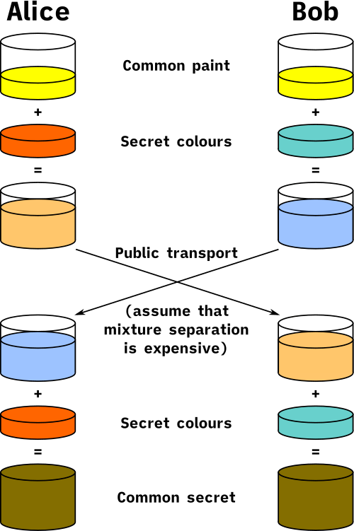
Security and SSL
Diffie Hellman Key Exchange
Alice and Bob have secret numbers a, b known only to themselves
Pick p and g commonly known to both and must be relative primes
Alice use secret a and send A = g^a mod p
Bob use secret b and send B = g^b mod p
Alice compute s1 = B^a mod p
Bob compute s2 = A^b mod p
By the properties of primes and modulo arithmetic s1==s2 and we have established a shared key.

Slide 42
Security and SSL
Authentication/Non-repudiation
TLS certs
Server has both a Pub and Priv key
Something encrypted with the Priv key can be decrypted by the Pub key
Something encrypted with the Pub key can be decrypted only by the Priv key
Server send a hash of its certificate encrypted with the private key to client
Client decrypts the hash using the public key, calculates the hash independently and compares the decrypted with its own
Client send a random message to server encrypted with the public key and waits for the server to send the original message back.
Authentication completed!
For non-repudiation: Require the client to also provide a small piece of data signed with their private key in the middle of the communication and you get non-repudiation!

Slide 43

Availability

Slide 44

What is Availability?
Availability refers to a property of software that it is there and ready to carry out its task when you need it to be.
This is a broad perspective and encompasses what is normally called reliability.
Availability builds on reliability by adding the notion of recovery (repair).
Fundamentally, availability is about minimizing service outage time by mitigating faults.

Slide 45
Availability General Scenario
Portion of Scenario | Possible Values
Source | Internal/external: people, hardware, software, physical infrastructure, physical environment
Stimulus | Fault: omission, crash, incorrect timing, incorrect response
Artifact | System’s processors, communication channels, persistent storage, processes
Environment | Normal operation, startup, shutdown, repair mode, degraded operation, overloaded operation
Response | Prevent the fault from becoming a failure Detect the fault: log the fault notify appropriate entities (people or systems) Recover from the fault disable source of events causing the fault be temporarily unavailable while repair is being effected fix or mask the fault/failure or contain the damage it causes operate in a degraded mode while repair is being effected
Response Measure | Time or time interval when the system must be available Availability percentage (e.g. 99.999%) Time to detect the fault Time to repair the fault Time or time interval in which system can be in degraded mode Proportion (e.g., 99%) or rate (e.g., up to 100 per second) of a certain class of faults that the system prevents, or handles without failing

Slide 46

Sample Concrete Availability Scenario
The heartbeat monitor determines that the server is nonresponsive during normal operations. The system informs the operator and continues to operate with no downtime.

Slide 47
MTTF and MTTR
Mean Time to Failure and Mean Time to Recovery
How long it takes for something to fail (i.e. 1 year) and to recover from that failure (i.e. 5 seconds). Availability = MTTF / (MTTF+MTTR)
When using multiple components with independent failure properties then you need to consider the cumulative failure rate.
Example: 10,000 server Hadoop computation with 8 HDDs per server.
HDDs fails 1%/year.
Computation lasts 1 day. What are odds of failure?
80000 * 1% * 1/365 ~= 2.2 expected failures in a day. Absent some mitigation this computation would never finish

Slide 48
Typical HW failure rates
HDD: 1-2%/year of all HDD in a DC fail
SSD: 0.5-1%/year of all SSD in a DC fail
DRAM: 0.1-0.3%/year of all DRAM modules in a DC fail
Recoverable memory errors (lose some DRAM capacity) are more frequent (25+% year)
NIC: 0.5%/year of all NICs in a DC fail
Motherboards: 0.5-1%/year of all motherboards in a DC fail
CPUs: <0.1%/year of all CPUs in a DC fail
GPUs: 0.3-0.5%/year of all GPUs in a DC fail

Slide 49

Modifiability

Slide 50
What is Modifiability?
Modifiability is about change and our interest in it is in the cost and risk of making changes.
To plan for modifiability, an architect has to consider three questions:
What can change?
What is the likelihood of the change?
When is the change made and who makes it?

Slide 51
Modifiability General Scenario
Portion of Scenario | Possible Values
Source | End user, developer, system administrator
Stimulus | A directive to add/delete/modify functionality, or change a quality attribute, capacity, or technology
Artifacts | Code, data, interfaces, components, resources, configurations, …
Environment | Runtime, compile time, build time, initiation time, design time
Response | One or more of the following: make modification test modification deploy modification
Response Measure | Cost in terms of: number, size, complexity of affected artifacts effort calendar time money (direct outlay or opportunity cost) extent to which this modification affects other functions or quality attributes new defects introduced

Slide 52

Sample Concrete Modifiability Scenario
The developer wishes to change the user interface by modifying the code at design time. The modifications are made with no side effects within three hours.

Slide 53
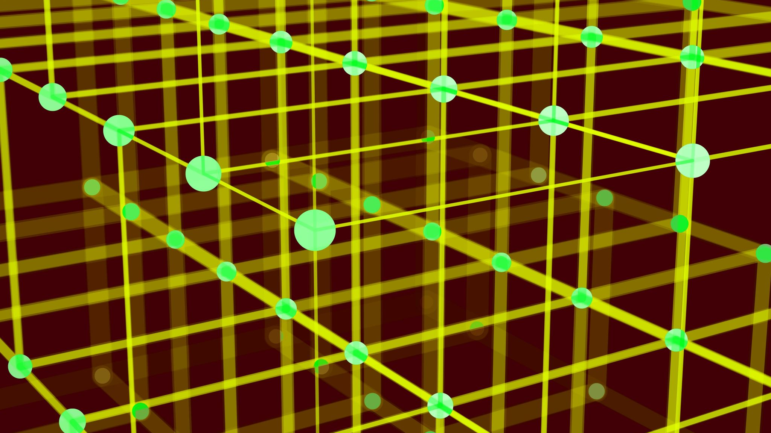
Interoperability

Slide 54

What is Interoperability?
Interoperability is about the degree to which two or more systems can usefully exchange meaningful information.
Like all quality attributes, interoperability is not a yes-or-no proposition but has shades of meaning.

Slide 55
Interoperability General Scenario
Portion of Scenario | Possible Values
Source | A system
Stimulus | A request to exchange information among system(s).
Artifact | The systems that wish to interoperate
Environment | System(s) wishing to interoperate are discovered at run time or known prior to run time.
Response | One or more of the following: the request is (appropriately) rejected and appropriate entities (people or systems) are notified the request is (appropriately) accepted and information is exchanged successfully the request is logged by one or more of the involved systems
Response Measure | One or more of the following: percentage of information exchanges correctly processed percentage of information exchanges correctly rejected

Slide 56
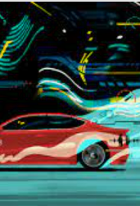
Sample Concrete Interoperability Scenario
Our vehicle information system sends our current location to the traffic monitoring system. The traffic monitoring system combines our location with other information, overlays this information on a Google Map, and broadcasts it. Our location information is correctly included with a probability of 99.9%.

Slide 57

Performance

Slide 58

What is Performance?
Performance is about time and the software system’s ability to meet timing requirements.
When events occur – interrupts, messages, requests from users or other systems, or clock events marking the passage of time – the system, or some element of the system, must respond to them in time.
Characterizing the events that can occur (and when they can occur) and the system or element’s time-based response to those events is the essence is discussing performance.

Slide 59
Performance General Scenario
Portion of Scenario | Possible Values
Source | Internal or external to the system
Stimulus | Arrival of a periodic, sporadic, or stochastic event
Artifact | System or one or more components in the system.
Environment | Operational mode: normal, emergency, peak load, overload.
Response | Process events, change level of service
Response Measure | Latency, deadline, throughput, jitter, miss rate

Slide 60
Sample Concrete Performance Scenario
Users initiate transactions under normal operations. The system processes the transactions with an average latency of two seconds.

Slide 61
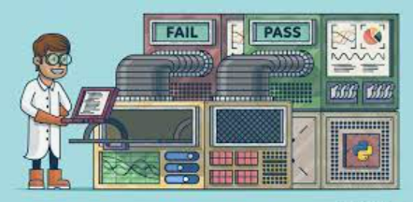
Testability

Slide 62
What is Testability?
Software testability refers to the ease with which software can be made to demonstrate its faults through (typically execution-based) testing.
Specifically, testability refers to the probability, assuming that the software has at least one fault, that it will fail on its next test execution.
If a fault is present in a system, then we want it to fail during testing as quickly as possible.

Slide 63
What is Testability?
For a system to be properly testable, it must be possible to control each component’s inputs (and possibly manipulate its internal state) and then to observe its outputs (and possibly its internal state).

Slide 64
Testability General Scenario
Portion of Scenario | Possible Values
Source | Unit testers, integration testers, system testers, acceptance testers, end users, either running tests manually or using automated testing tools
Stimulus | A set of tests are executed due to the completion of a coding increment such as a class, layer or service; the completed integration of a subsystem; the complete implementation of the system; or the delivery of the system to the customer.
Environment | Design time, development time, compile time, integration time, deployment time, run time
Artifacts | The portion of the system being tested
Response | One or more of the following: execute test suite and capture results; capture activity that resulted in the fault; control and monitor the state of the system
Response Measure | One or more of the following: effort to find a fault or class of faults, effort to achieve a given percentage of state space coverage; probability of fault being revealed by the next test; time to perform tests; effort to detect faults; length of longest dependency chain in test; length of time to prepare test environment; reduction in risk exposure (size(loss) * prob(loss))

Slide 65
Sample Concrete Testability Scenario
The unit tester completes a code unit during development and performs a test sequence whose results are captured and that gives 85% path coverage within 3 hours of testing.

Slide 66

Usability

Slide 67
What is Usability?
Usability is concerned with how easy it is for the user to accomplish a desired task and the kind of user support the system provides.
Over the years, a focus on usability has shown itself to be one of the cheapest and easiest ways to improve a system’s quality (or, more precisely, the user’s perception of quality).

Slide 68
What is Usability?
Usability comprises the following areas:
Learning system features.
Using a system efficiently.
Minimizing the impact of errors.
Adapting the system to user needs.
Increasing confidence and satisfaction.

Slide 69
Usability General Scenario
Portion of Scenario | Possible Values
Source | End user, possibly in a specialized role
Stimulus | End user tries to use a system efficiently, learn to use the system, minimize the impact of errors, adapt the system, or configure the system
Environment | Runtime or configuration time
Artifacts | System or the specific portion of the system with which the user is interacting.
Response | The system should either provide the user with the features needed or anticipate the user’s needs.
Response Measure | One or more of the following: task time, number of errors, number of tasks accomplished, user satisfaction, gain of user knowledge, ratio of successful operations to total operations, or amount of time or data lost when an error occurs.

Slide 70
Sample Concrete Usability Scenario
The user downloads a new application and is using it productively after two minutes of experimentation.

Slide 71
Quality Attributes in Practice
In practice, there are other quality attributes that are not so familiar, for example: calibrateability
Some quality attributes are domain specific.
Single word descriptions of quality attribute properties are meaningless – wide open to interpretation!
Its not important what term we use, but make sure that it is characterized in a quality attribute scenario - conveys the real meaning of the “ility”

Slide 72
Achieving Quality Attributes Through Tactics
There are a collection of primitive design techniques that an architect can use to achieve a quality attribute response.
We call these architectural design primitives tactics.
Tactics, like design patterns, are techniques that architects have been using for years. We do not invent tactics, we simply capture what architects do in practice.
We will discuss tactics more during the “Software Architecture” part of the course.

Slide 73
Common Tactics
Performance Tactics
Goal: Reduce latency or increase throughput.
Resource management: increase computational resources, concurrency, or priority-based scheduling.
Resource arbitration: load balancing, caching, compression, prefetching.
Availability Tactics
Goal: Ensure the system continues to operate despite failures.
Fault detection: heartbeat messages, ping/echo.
Fault recovery: restart, rollback, or failover.
Fault prevention: remove single points of failure.
Security Tactics
Goal: Protect data and resources from unauthorized access or modification.
Detect attacks: intrusion detection, audit logging.
Resist attacks: authentication, authorization, encryption.
Recover from attacks: restore from backup, revoke compromised keys.
Modifiability Tactics
Goal: Make the system easier to change.
Localize changes: encapsulation, layering, use of interfaces.
Prevent ripple effects: use indirection, abstract dependencies.
Defer binding: runtime configuration or dynamic linking.

Slide 74
Common Tactics
Usability Tactics
Goal: Improve user experience and reduce errors.
Support user initiative: undo/redo, help systems.
Support system initiative: guidance, feedback, tutorials.
Testability Tactics
Goal: Make it easier to verify and validate the system.
Add visibility: logging, tracing, exposing state.
Add controllability: simulation environments, stubs, dependency injection.
Safety Tactics
Goal: Prevent or mitigate hazards and failures.
Fault isolation: redundancy, partitioning.
Safe states: rollback to known safe mode on erro

Slide 75

In class Exercise
Imagine a web-based platform and mobile app that allows users to order food from a variety of restaurants and have it delivered to their doorstep.
This system connects customers, restaurants, and delivery drivers to provide a convenient food ordering and delivery service.
Use this system as the basis for brainstorming quality attribute scenarios.

Slide 76
Key Features of the system
User registration and profiles.
Restaurant listings with menus and pricing.
Ordering and payment processing.
Real-time order tracking.
Restaurant and user reviews and ratings.
GPS-based location tracking for delivery.
Customer support chat.

Slide 77

1- In your project teams
2- Each team select 2 quality requirements from the list and write one quality scenario for each:
Security
Usability
Performance
Availability
Interoperability
Modifiability
Testability
3- Post your scenarios in Piazza for the rest of the class to see.

Slide 78
Examples to Consider
Security Scenario: A user's account gets locked after three failed login attempts. How should the system respond to this security event?
Usability Scenario: A new user struggles to find a specific cuisine option in the menu. How can the system improve the user interface to make this easier?
Reliability Scenario: During a major sporting event, the platform experiences a surge in orders. How should the system maintain reliability and responsiveness?
Performance Scenario: The system takes more than 10 seconds to load the restaurant menu on a mobile device. What performance improvements can be made?
Availability Scenario: The platform needs to undergo scheduled maintenance. How can users be informed, and how can the downtime be minimized?
Maintainability Scenario: A new restaurant wants to join the platform. How can the system be designed to easily onboard new restaurants?
Interoperability Scenario: How can the platform ensure that it can integrate with various restaurant POS systems and external payment gateways seamlessly?

Slide 79


Readings , Assignments, Project Tasks
Read: (These readings are optional)
“On-Non Functional Requirements” - optional reading available in Supplemental Readings
“Are Non-functional” Requirements really Non-functional?” optional reading available in Supplemental Readings
Assignments & Project Tasks:
Deliverable 4 is due by next Friday.

Slide 80

Questions?

